Slide 1
Using the pipets
(properly)

Slide 2
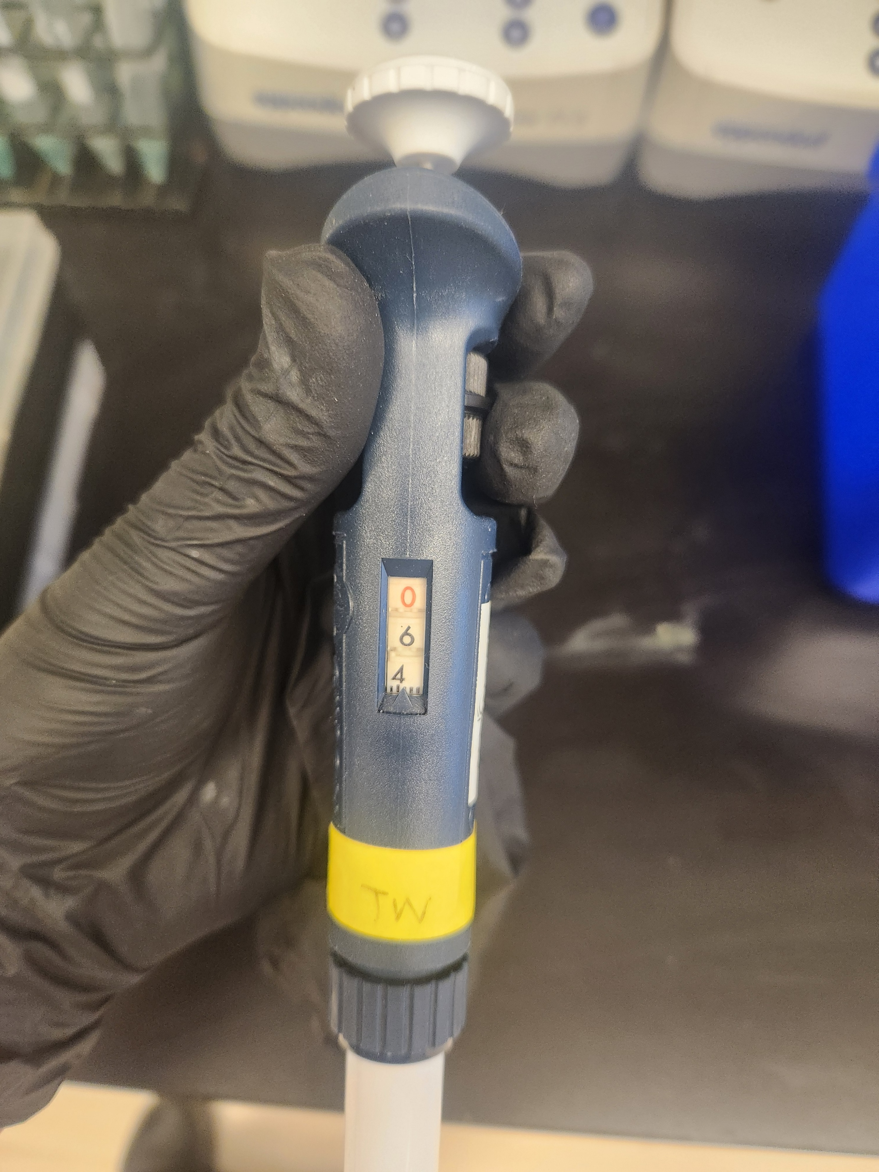
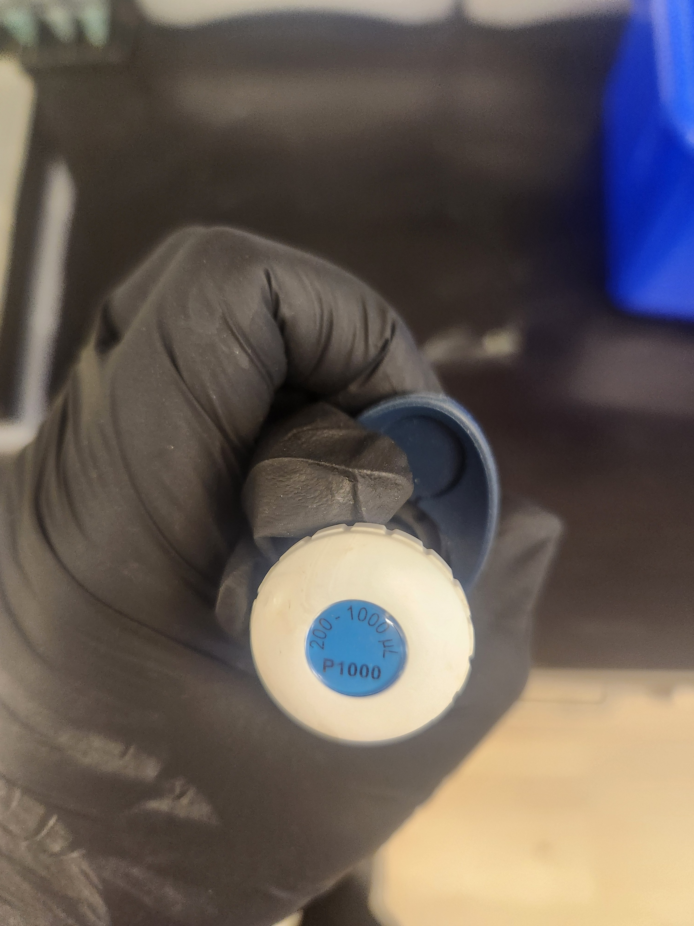
This is a P1000
This pipet goes from 100-1000 uL with an accuracy of 1 uL
This pipet currently reads 639 uL
Do not just leave this at the highest or lowest value. Pipets function by a spring. Compressing or stretching the spring for too long, or outside of it’s bounds, damage the spring and de-calibrate the pipet.
This is the 1000s place.
This is the 100s place.
This is the 10s place.
This is the 1s place (the gradiation marks).
This is the range of volume it covers.
Do not go above the highest #, or below the lowest #.

Slide 3
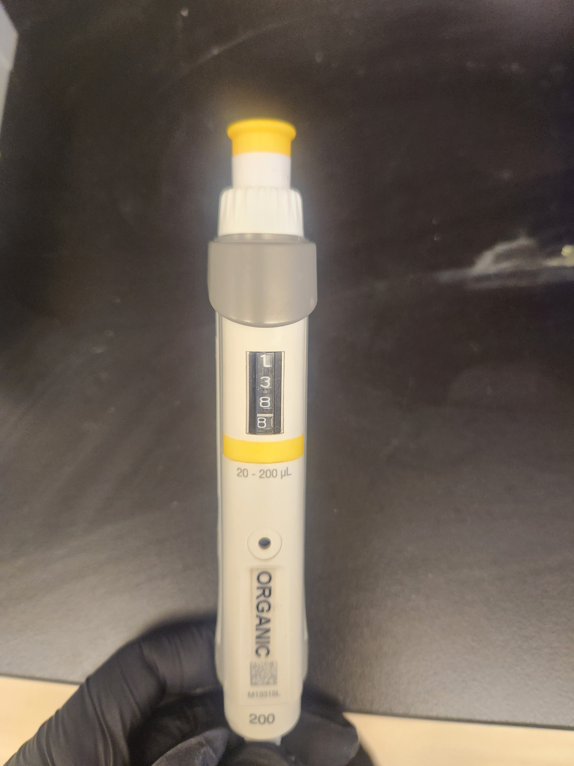
This is a P200
This pipet goes from 20.0-200.0 uL with an accuracy of 0.1 uL
This pipet currently reads 138.8 uL
Do not just leave this at the highest or lowest value. Pipets function by a spring. Compressing or stretching the spring for too long, or outside of it’s bounds, damage the spring and de-calibrate the pipet.
This is the 100s place.
This is the 10s place.
This is the 1s place.
This is the 10ths place.
This is the range of volume it covers.
Do not go above the highest #, or below the lowest #.

Slide 4
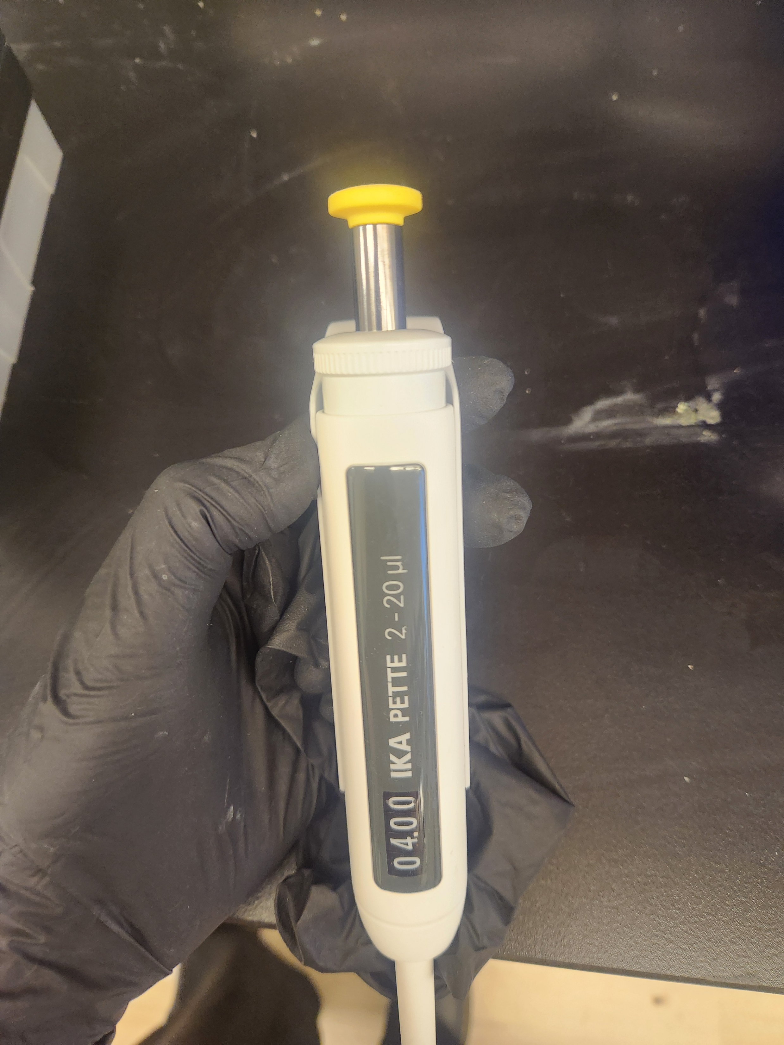
This is a P20
This pipet goes from 2.00-20.00 uL with an accuracy of 0.01 uL
This pipet currently reads 4.00 uL
This is the range of volume it covers.
Do not go above the highest #, or below the lowest #.
Do not just leave this at the highest or lowest value. Pipets function by a spring. Compressing or stretching the spring for too long, or outside of it’s bounds, damage the spring and de-calibrate the pipet.
This is the 100ths place.
This is the 10ths place.
This is the 1s place.
This is the 10s place.

Slide 5
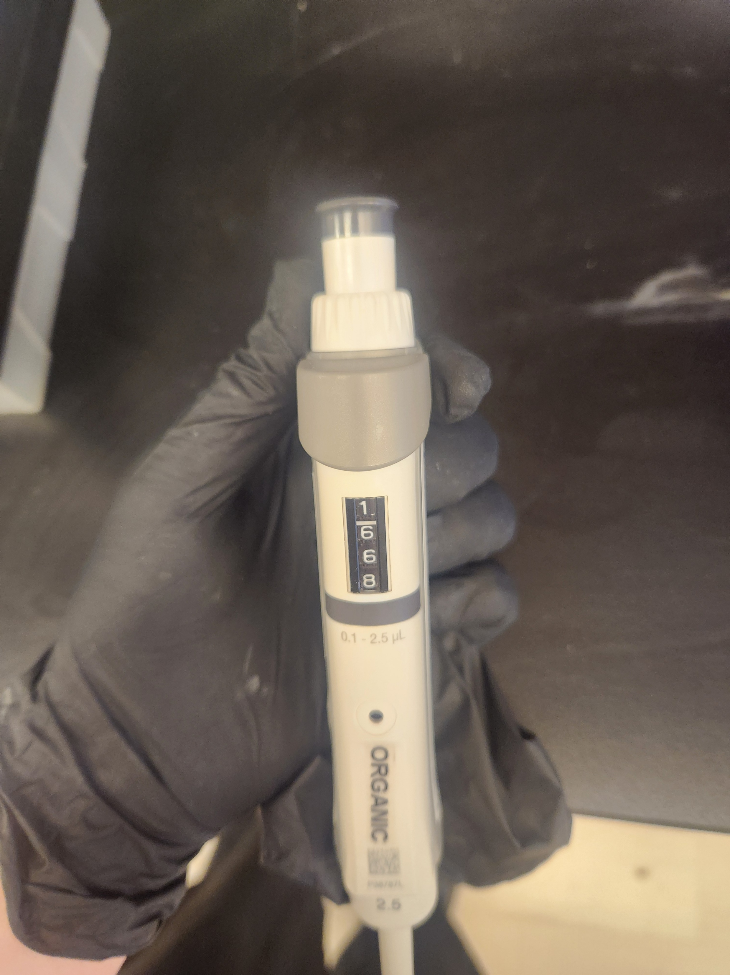
This is a P2.5
This pipet goes from 0.1-2.5 uL with an accuracy of 0.001 uL
This pipet currently reads 1.668 uL
Do not just leave this at the highest or lowest value. Pipets function by a spring. Compressing or stretching the spring for too long, or outside of it’s bounds, damage the spring and de-calibrate the pipet.
This is the 1s place.
This is the 10ths place.
This is the 100ths place.
This is the 1000ths place.
This is the range of volume it covers.
Do not go above the highest #, or below the lowest #.

Slide 6
